Slide 1


Analysis of Sample Superstore Dataset

Slide 2
STUDENT DETAILS
Name:- Jainish Patel
Skillsbuild Email:- jainishp293@gmail.com
College:- LDRP Institute of Technology and Research
Internship Domain:- Data Analytics (DA)
Start Date:- 12/06/2023
End Date:- 24/07/2023
Internship ID:- INTERNSHIP_168198413964410a8b547b1
AICTE Student ID:- Student ID:- STU643e417d104b11681801597

Slide 3
PROJECT TITLE/Problem Statement
Analysis of Sample Superstore Dataset
The problem statement of the Sample Superstore dataset is to analyze the sales and profit data of a fictional superstore company and identify areas where improvements can be made to increase profitability and overall business performance.
The dataset contains information such as sales, profit, region, category, and various other attributes for a range of products sold by the superstore.

Slide 4
AGENDA
Introduction:
Briefly introducing the purpose and scope of the analysis.
Providing an overview of the Sample Superstore dataset and its key attributes.
Data Exploration:
Describing the dataset's structure, columns, and data types.
Presenting summary statistics and visualizations to give an initial understanding of the data.
Sales and Profit Analysis:
Presenting sales trends over time, such as monthly or yearly patterns.
Discussing the distribution of sales and profit across different product categories or sub-categories.
Analyzing profit margins and identify top-performing and underperforming segments.

Slide 5
Customer Segmentation:
Explaining the customer segmentation methodology employed.
Presenting key customer segments based on purchasing behavior.
Discussing the characteristics and contribution of each segment to sales and profit.
Geographic Analysis:
Exploring regional sales and profit distribution.
Identifying regions with the highest and lowest sales/profit.
Highlighting regional sales trends and potential growth opportunities.
Product Performance Analysis:
Discussing the performance of individual products.
Identifying top-performing and underperforming products within each category/sub-category.
Providing insights for product assortment, promotion, and potential discontinuation.

Slide 6
Customer Satisfaction Analysis:
Presenting findings from customer feedback, ratings, or reviews.
Identifying common issues or patterns impacting customer satisfaction.
Suggesting strategies to enhance customer service, product quality, or delivery processes.
Recommendations and Insights:
Summarizing key insights and findings from the analysis.
Providing actionable recommendations to improve profitability and business performance.
Outlining next steps, such as implementing specific strategies or conducting further analysis.
Conclusion:
Concluding the analysis project and summarizing the key takeaways.
Reflecting on the limitations of the analysis and potential areas for further exploration.

Slide 7
Project Overview
Purpose:
The purpose of this project is to analyze the sales and profit data of a fictional superstore company, as represented in the Sample Superstore dataset. By conducting a comprehensive analysis, the project aims to provide insights and recommendations to enhance the company's profitability, optimize operations, and improve overall business performance.
Scope:
The scope of this project is to analyze the Sample Superstore dataset, which includes information about sales, profit, region, category, and various other attributes related to the products sold by the superstore. The analysis will focus on understanding sales trends, profitability, customer segmentation, geographic performance, product performance, inventory management, and customer satisfaction. The project aims to provide actionable insights specific to these areas, enabling the superstore company to make informed decisions and drive positive outcomes.

Slide 8
Objectives:
Understand Sales Trends: Identify patterns and trends in sales data to uncover seasonal variations, popular product categories, and regions with high or low sales volumes.
Analyze Profitability: Assess profit margins for different product categories, identify top-performing and underperforming segments, and investigate factors impacting profitability.
Customer Segmentation: Segment customers based on purchasing behavior, demographics, or geographic location to identify target segments for personalized marketing strategies and improved customer engagement.
Geographic Analysis: Evaluate sales performance across different regions, identify growth opportunities, and uncover regions that require attention for improvement.
Product Performance Analysis: Assess the performance of individual products, identify top-performing and underperforming products, and make data-driven decisions regarding product assortment and promotional strategies.

Slide 9
Inventory Management: Analyze inventory levels, stockouts, and reorder frequency to optimize inventory management, reduce costs, and ensure efficient supply chain operations.
Customer Satisfaction Analysis: Explore customer feedback and ratings to identify areas for improvement in customer service, product quality, or delivery processes, ultimately enhancing overall customer satisfaction.

Slide 10
WHO ARE THE END USERS OF THIS PROJECT?
The end users of the project analysis of the Sample Superstore dataset can vary depending on the organization or stakeholders involved in the superstore company. Some of the key end users can include:
Senior Management: The senior management team, including executives and decision-makers, would be interested in the analysis to gain strategic insights into the overall performance of the superstore. They can use the findings and recommendations to make informed decisions related to business expansion, resource allocation, and long-term planning.

Slide 11
Operations Managers: Operations managers would be interested in the analysis to optimize day-to-day operations within the superstore. Insights related to inventory management, product performance, and customer satisfaction can help them enhance operational efficiency and improve processes.
Sales and Marketing Teams: The sales and marketing teams would benefit from customer segmentation analysis and product performance insights to tailor their marketing strategies and promotions. They can identify target customer segments and create personalized marketing campaigns to drive sales.
Supply Chain and Inventory Managers: Supply chain and inventory managers would use the analysis to optimize inventory levels, determine reorder points, and reduce stockouts. This can help them maintain an efficient supply chain and minimize costs associated with inventory management.

Slide 12
Customer Service Team: The customer service team would be interested in customer satisfaction analysis to address customer feedback and improve service quality. Insights from the analysis can lead to better customer engagement and retention.
Financial Analysts: Financial analysts can leverage the analysis to understand profitability trends, cost structures, and opportunities for cost optimization. This can assist in financial planning and budgeting for the superstore company.
Business Analysts and Data Scientists: Analysts and data scientists involved in the project would be end users themselves, as they would be responsible for conducting the analysis and deriving actionable insights.
Investors and Shareholders: External stakeholders, such as investors and shareholders, may also be interested in the analysis as it provides a transparent view of the company's performance and growth prospects.

Slide 13
Solution and its value proposition
The solution for analyzing the Sample Superstore dataset involves a comprehensive data analysis and actionable insights that can empower the superstore company to make informed decisions, optimize operations, and enhance profitability. The value proposition of this solution lies in the following key aspects:
Data-Driven Decision Making: By conducting a thorough analysis of the dataset, the solution enables the superstore company to base its decisions on data rather than assumptions or intuition. This data-driven approach ensures that strategies and actions are aligned with actual market trends, customer preferences, and business performance.

Slide 14
Identifying Growth Opportunities: The analysis helps identify growth opportunities by highlighting high-potential product categories, profitable customer segments, and regions with untapped potential. Leveraging these insights, the company can focus on strategic expansion and marketing efforts in promising areas.
Operational Efficiency: The solution provides insights into inventory management, supply chain optimization, and product performance. By making data-backed decisions in these areas, the superstore company can reduce costs, minimize stockouts, and streamline operations, leading to improved efficiency.
Personalized Marketing Strategies: Customer segmentation analysis allows the superstore to tailor marketing strategies to specific customer groups. Personalized marketing efforts can lead to higher customer engagement, increased loyalty, and ultimately, improved sales.

Slide 15
Customer Satisfaction Enhancement: The analysis of customer feedback and satisfaction levels enables the company to identify pain points and areas for improvement. Implementing changes based on these insights can enhance customer experience and drive greater customer loyalty.
Competitor Insights: The analysis can provide a comparative view of the superstore's performance against competitors in the market. Understanding how the superstore fares in terms of sales, profit, and customer satisfaction relative to competitors helps in identifying areas where the company can gain a competitive edge.
Optimal Product Assortment: By identifying top-performing and underperforming products, the solution helps in optimizing the product assortment. The superstore can focus on promoting high-performing products and consider discontinuing low-performing ones to better meet customer demands.

Slide 16
Return on Investment (ROI) Maximization: The insights derived from the analysis allow the superstore company to allocate resources effectively. By investing in high-return areas, the company can maximize ROI and allocate its budget more efficiently.
Overall, the solution's value proposition lies in its ability to empower the superstore company with valuable insights, enabling data-driven decision-making, and supporting various strategic initiatives to achieve business growth, profitability, and enhanced customer satisfaction. The analysis offers a holistic view of the company's performance, identifies opportunities for improvement, and provides actionable recommendations to drive the superstore's success in a competitive market.

Slide 17
HOW DID I CUSTOMIZE THE PROJECT AND MAKE IT My OWN?
Personalized Project Objectives: I would review the initial project objectives and consider any additional goals or specific areas of focus that align with my expertise or interests.
Reflecting Personal Style: I would infuse my personal style into the project by using clear and concise language, incorporating effective storytelling techniques, and presenting the analysis results in a visually appealing and engaging format.
Real-world Implementation Strategies: While recommendations are a crucial part of the project, I would ensure they are practical and actionable. This could involve providing specific implementation strategies, such as launching loyalty programs, optimizing pricing structures, or improving inventory management, to support the management team in implementing the recommended changes.

Slide 18
Analysis Techniques: While the project might include suggested analysis techniques, I would bring in my knowledge of advanced analytics methods or specialized statistical models that could provide deeper insights. This could involve incorporating predictive modeling, time series analysis, or sentiment analysis to enhance the project's value and generate more accurate predictions or actionable recommendations.
Creative Data Visualization: To present the analysis findings in a visually appealing and easily understandable manner, I might explore creative data visualization techniques beyond the typical charts and graphs. This could involve using interactive dashboards, storytelling techniques, or infographics to engage stakeholders and convey the insights effectively.
Domain-specific Insights: Drawing from my domain knowledge or prior experience, I would provide context-specific insights that go beyond the basic analysis

Slide 19
Modelling
Predictive Modeling: Build predictive models to forecast sales, demand, or customer behavior. Techniques such as regression analysis, time series analysis, or machine learning algorithms like linear regression, random forests, or gradient boosting can be applied to predict future outcomes based on historical data.
Sentiment Analysis: Natural Language Processing (NLP) techniques can be applied to analyze customer feedback and sentiment, identifying positive and negative sentiments and understanding customer satisfaction levels.
Regression Analysis: Regression models can be applied to understand the relationships between variables. For example, a regression model can be used to examine how sales are influenced by factors like price, promotions, or advertising expenditure.

Slide 20
Customer Segmentation: Clustering algorithms, like K-means or DBSCAN, can be employed to segment customers based on their purchasing behavior, allowing the superstore to tailor marketing strategies to different customer groups.
Market Basket Analysis: Association rule mining can be used to discover frequent item sets in customer transactions, helping to identify products that are often purchased together and supporting cross-selling strategies.
Geographic Analysis: Geographic Information System (GIS) tools can be used to visualize sales and profit data on maps, helping to identify regional performance and potential growth opportunities.
Machine Learning Algorithms: Various machine learning algorithms, such as decision trees, random forests, or support vector machines, can be employed for tasks like product recommendation, sales forecasting, or customer churn prediction.

Slide 21
Optimization Modeling: Use mathematical optimization techniques like linear programming, integer programming, or network optimization to optimize inventory levels, pricing strategies, or supply chain operations. This modeling approach can help in maximizing profits or minimizing costs.

Slide 22
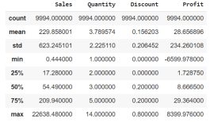
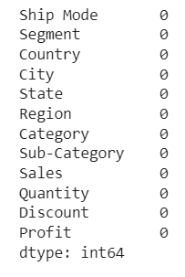
Results
From the analysis of it is inferred that average sales is 229.858001 USD, average profit is 28.656896 and average discount given is 0.156203.
This Dataset has no null values.

Slide 23
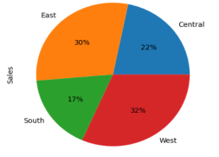
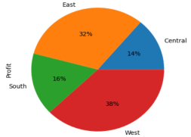
West region has the most sales with 32% and South region has the least sales with 17%. So we should focus more in South region and Central region .
For Profit to sales ratio West and East regions do very well. So we should make strategies to improve profit in South and Central regions.

Slide 24
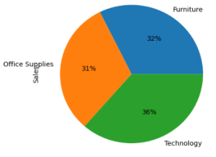
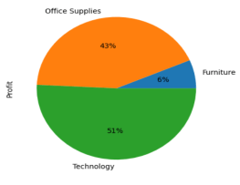
Here there is minor difference in category wise sales. Technology category has the most profit of 51% and Furniture gives the least profit of 6%. Office supplies also gives good profit of 43%.
We should improve profit in furniture category by increasing price or we should sale more technology and Office related products. For this we can allot greater budget to these categories.

Slide 25
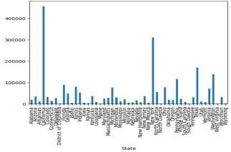
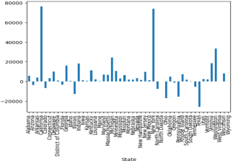
Here 1st Graph shows State wise sales. California has the most sales and some states like Malne, North Dakota, South Dakota, West Virginia.
Some of the States has negative profit means loss. Texas has the most loss and California has the most profit.
So we should consider loss making states and make strategy to convert loss in profit.

Slide 26
Links
Drive:-https://drive.google.com/drive/folders/1gicxd0qWrbrmN14bWsnwfuuA7PCCnH8j?usp=sharing
Google Collab:-https://drive.google.com/file/d/1GUjHz0oWhK_aH3c3cETsSKPVJGRkzKlf/view?usp=sharing
Dataset:- https://www.kaggle.com/datasets/bravehart101/sample-supermarket-dataset?resource=download
Reference Links:-https://www.analyticsvidhya.com/blog/2022/03/eda-on-superstore-dataset-using-python/
https://medium.com/clique-org/superstore-sales-use-case-data-analytics-and-visualization-62afacd0777

